Slide 1
ADMINISTRATION SYSTEM FOR VARDHAN HOSPITAL RAIPUR
Shri Shankaracharya Institute of Professional Management & Technology, Raipur
Minor Project Report on
CSE 7th Semester
Department of Computer Science and Engineering,
Batch 2018-2022
Session Jan – July 2021
Presentation Date:
Project group member;
Aditi Sharma 303302218076
Harsha Chhabda 303302218079
Mudita Tiwari 303302218081
Project Guide
Dr J.P Patra
(Head of department ,CSE)

Slide 2
Introduction And Objectives of project
The Hospital Management System (HMS) is designed for Any Hospital to replace their existing manual, paper based system. The new system is to control the following information; patient information, room availability, staff and operating room schedules, and patient invoices. These services are to be provided in an efficient, cost effective manner, with the goal of reducing the time and resources currently required for such tasks.
HMS will automate the management of the hospital making it more efficient and error free. It aims at standardizing data, consolidating data ensuring data integrity and reducing inconsistencies.

Slide 3
Application Area
The Hospital Management System (HMS) is designed for Any Hospital to replace their existing manual, paper based system. The new system is to control the following information; patient information, room availability, staff and operating room schedules, and patient invoices. These services are to be provided in an efficient, cost effective manner, with the goal of reducing the time and resources currently required for such tasks.
Hospitals , medical firms (Vardhan Hospital Raipur)
can be used in the areas where record of medical history of a patient required .
Can be used in medical facilities or health checkups test reports collection and for pharmacy purpose.

Slide 4
Project Requirements (End User)
Software’s Required
Web Technologies : PHP (Laravel Framework)
Database : MY SQL
Web Server : XAMPP
Operating System : WINDOWS (any Version
greater than 7.0

Slide 5
Project Requirements (Developer)
Software’s Required
Operating System : Any version of windows (greater then 7.0)
Scripting language: PHP
Front-End: PHP
Back-End: MY SQL
Web Server: XAMPP
Hardware Required (Minimum Requirement)
Intel Core
4 GB Ram, 512 KB Cache Memory, Hard disk 10 GB
Microsoft Compatible 101 or more Key Board

Slide 6
Back End Details
MYSQL
Other prerequisites.
Bootstrap
Php crud generator
Laravel framework
Datatables
Reporting tools

Slide 7
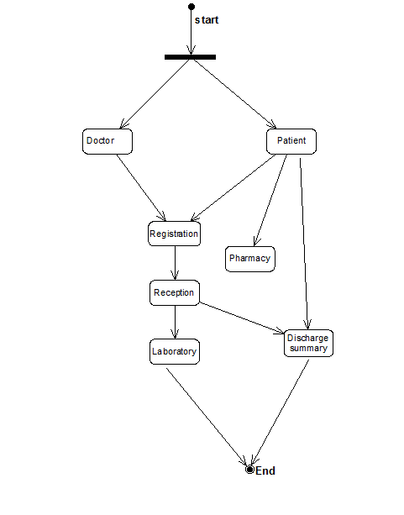
Data Flow Diagram

Slide 8
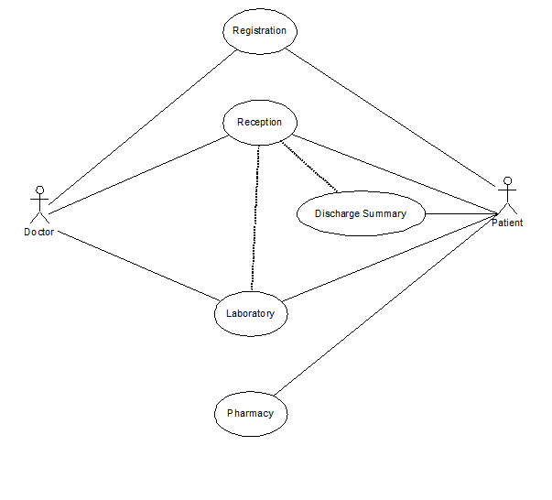

Slide 9
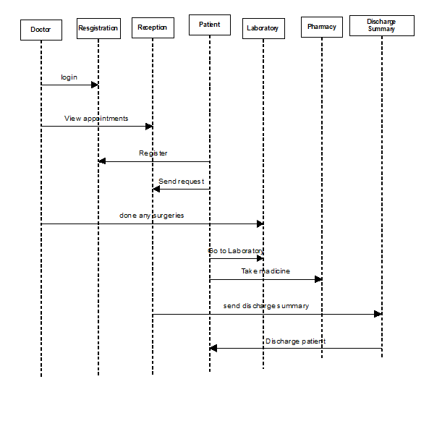
Work Flow Diagram

Slide 10
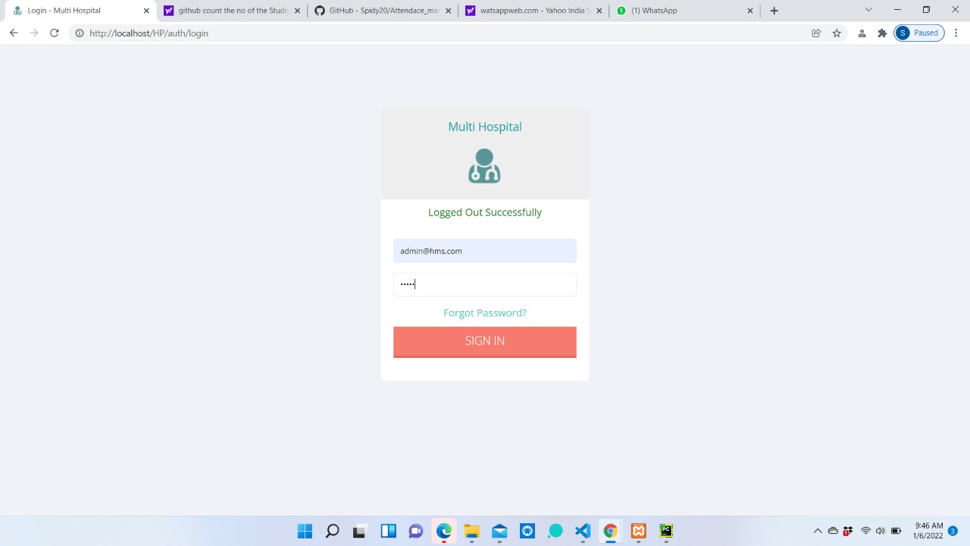
Front End Details HOME PAGE

Slide 11
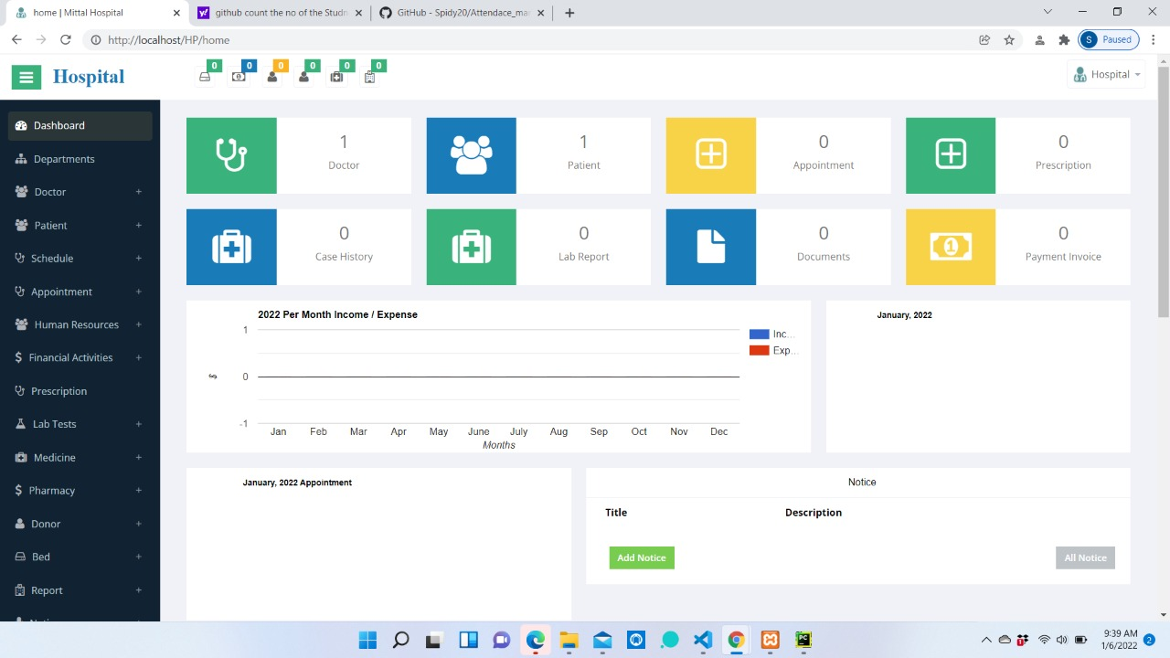
REGISTRATION PAGE

Slide 12
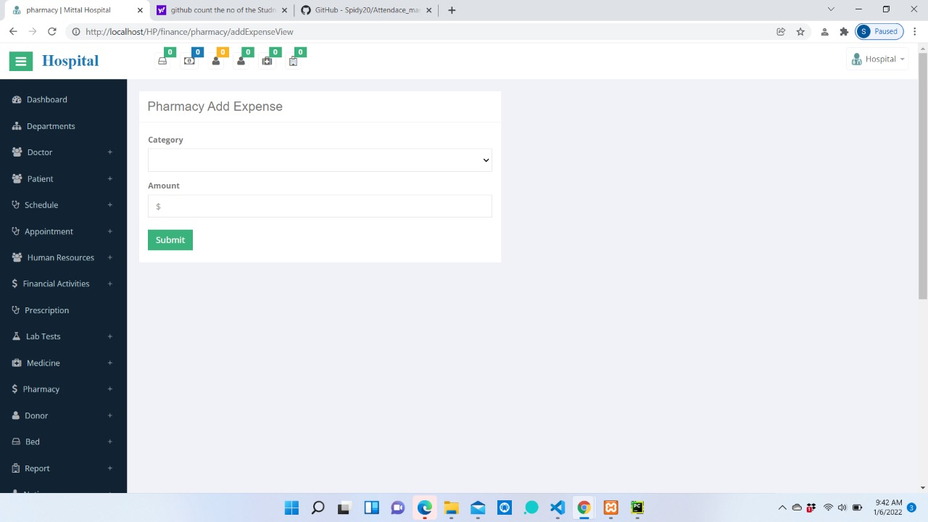
Inpatient Registration

Slide 13
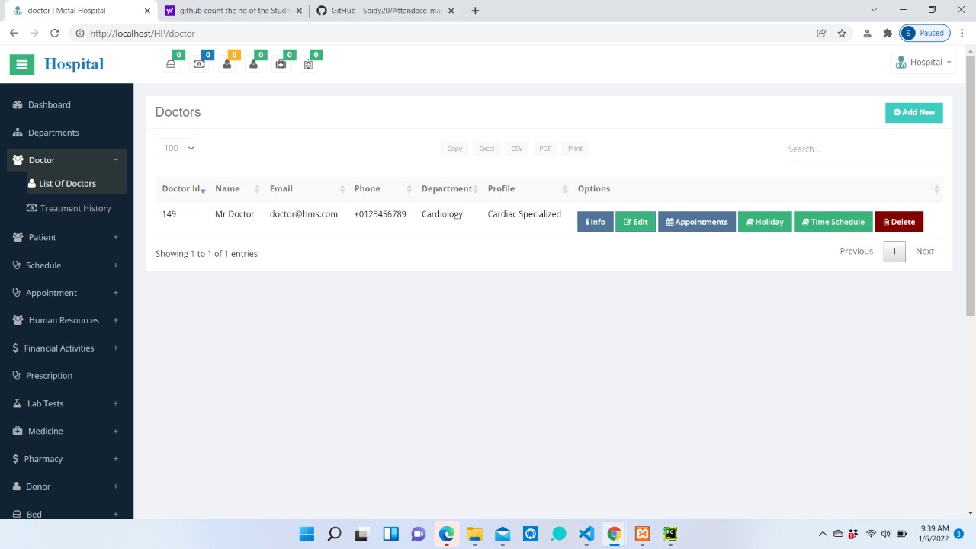
Adminstration

Slide 14
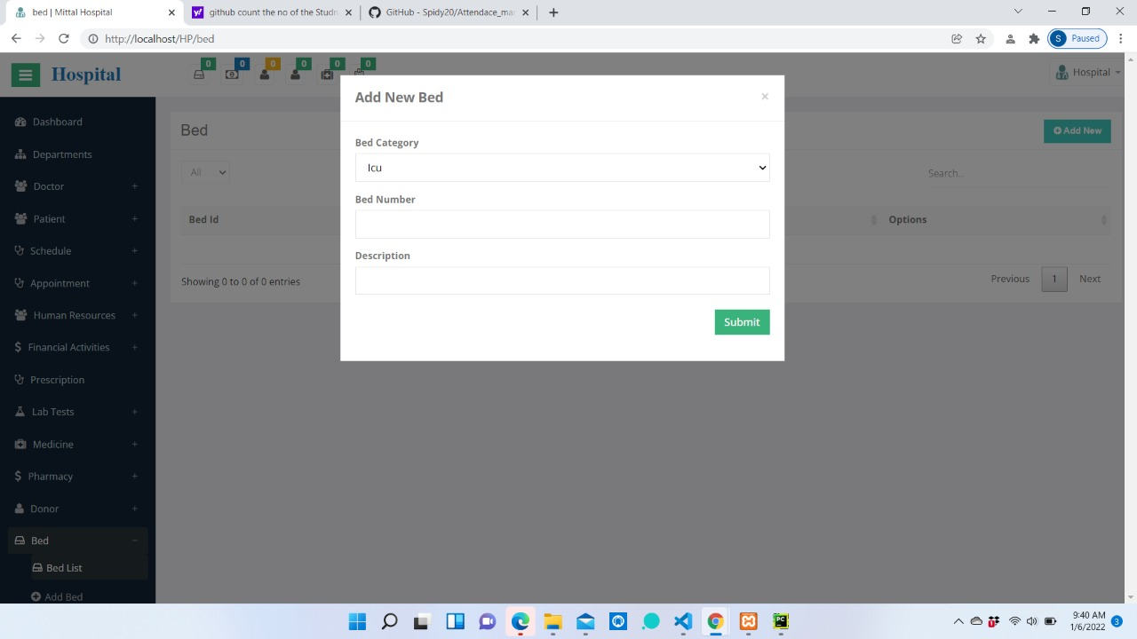

Slide 15
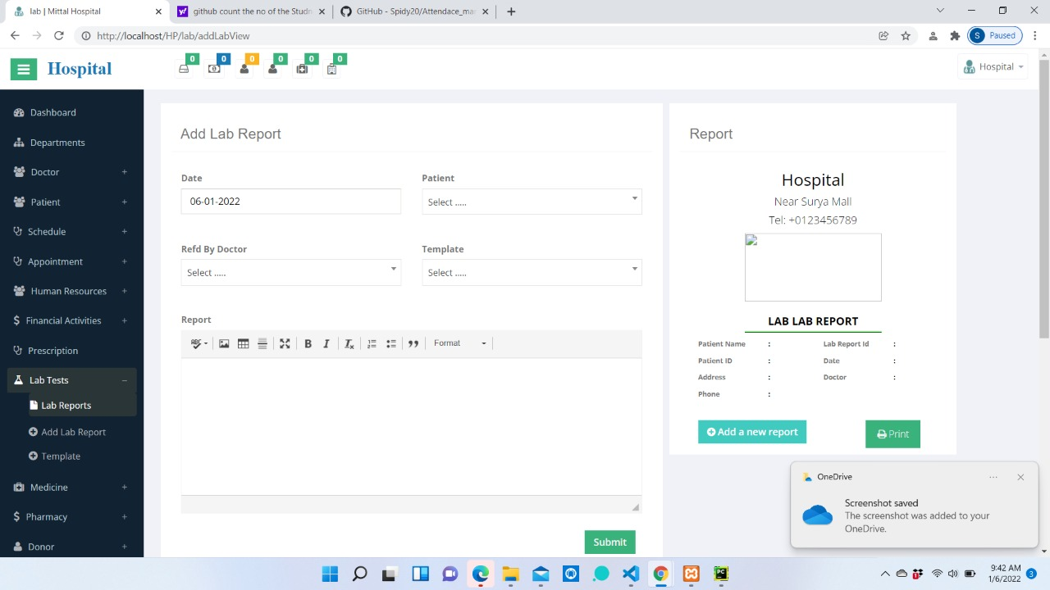
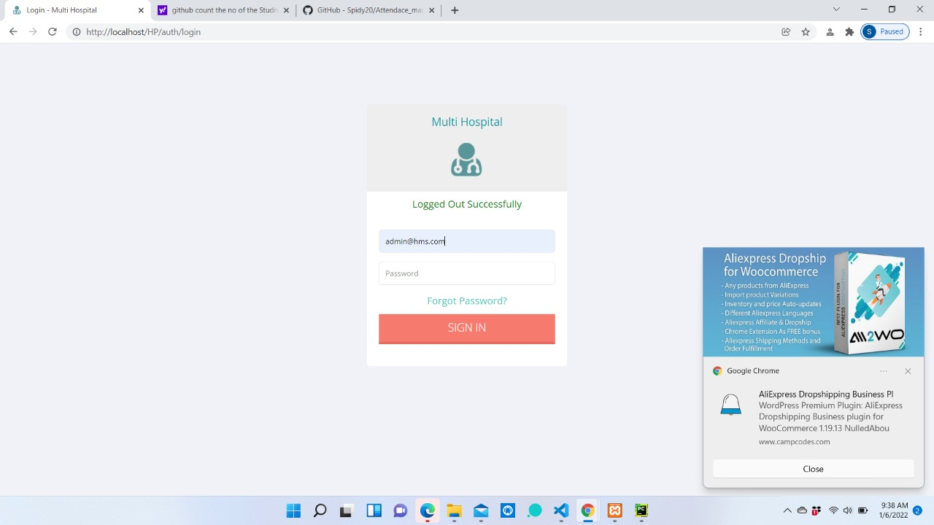

Slide 16
Expected Outcomes
Automation of the entire system improves the efficiency
It provides a friendly graphical user interface which proves to be better when compared to the existing system.
It gives appropriate access to the authorized users depending on their permissions.
It effectively overcomes the delay in communications.
Updating of information becomes so easier.
System security, data security and reliability are the striking features.
The System has adequate scope for modification in future if it is necessary.

Slide 17
Future scope
Will reduce the time of overall treatment by eliminating various parts which take unnecessary time.
Will provide an easier approach to make appointment.
The App can be extended to provide meeting setup to directly host meeting from inside of the app.
The app can also be connected to various host medical firms to get data for adding many new functionalities.
Recommendation system can be implemented using web services.

Slide 18
References
Text Book
PHP(LARAVEL FRAMEWORK) C# 2005 Apress Publications
C# COOK BOOK O reilly Publications
PROGRAMMING MICROSOFT ASP .NET 2.0 APPLICATION Wrox Professional Guide
Web Resources
www.google.com
www.microsoft.com

